Slide 1
A spokesperson with any name would not be as charming: The phonetic effect of spokesperson names on personality perceptions and brand attachment
Alicia Kulczynski
University of Newcastle, Australia
Stacey Baxter
University of Newcastle, Australia
Jasmina Ilicic
Monash University, Australia
CBRC
2019

Slide 2
who’s more Outdoorsy?
Jordon Rozzo
or
Jayden Razza

Slide 3
who’s more Outdoorsy?

Slide 4
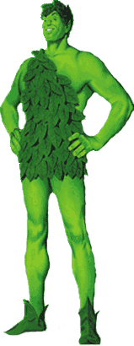
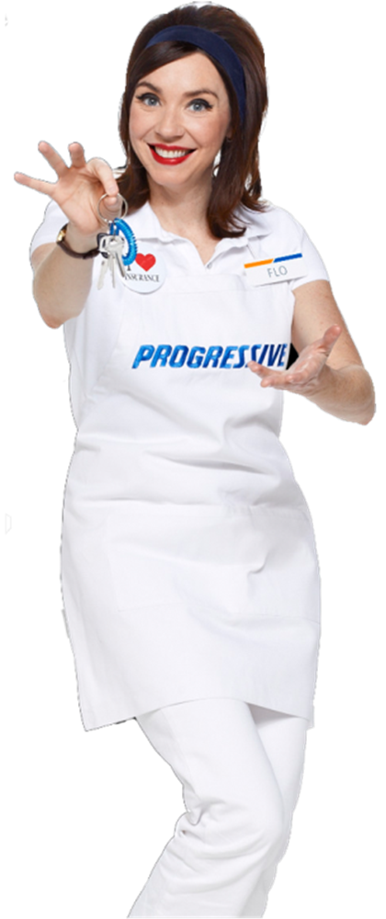
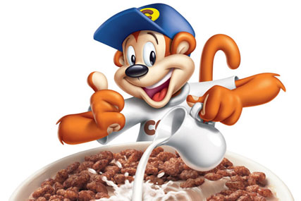
spokespeople
Used in advertising to attract attention
Ideal for humanising a brand
Assist in establishing brand personality
People, animals, characters, cartoons, puppets
Offer greater control than real celebrities

Slide 5
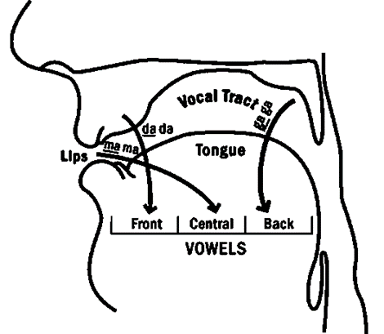
Phonetic symbolism
The sounds contained in spokesperson names (Ilicic et al., 2015), like brand names (Lowrey & Shrum, 2007) , contain meaning for consumers
Most research in marketing focuses on the front/back vowel sound distinction
[ä] (such as in brought) has been associated with large objects
[i] (such as in bring) associated with small objects (Tarte and Barritt, 1971)

Slide 6
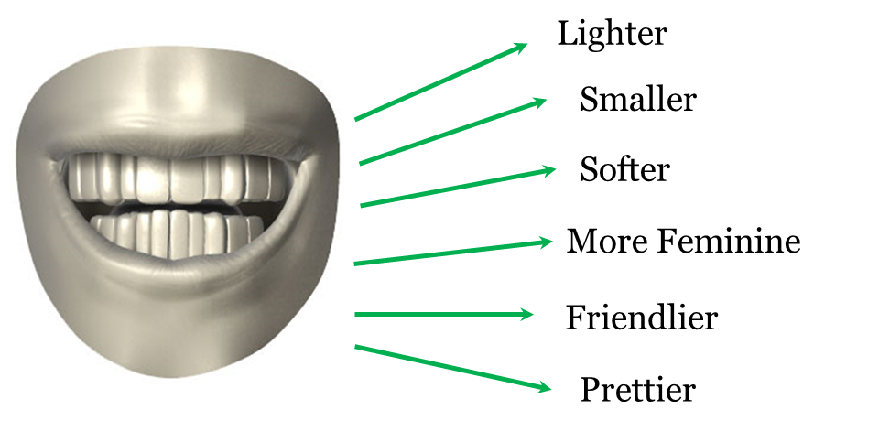
Phonetic symbolism
Phonemes (sounds in words) influence perceptions of product and brand attributes
(Coulter & Coulter, 2010; Klink, 2000; Lowrey & Shrum, 2007; Yorkston & Menon, 2004)
e.g. [i] contained in Gimmel or Nillen Vs [ä] contained in Gommel or Nollen

Slide 7
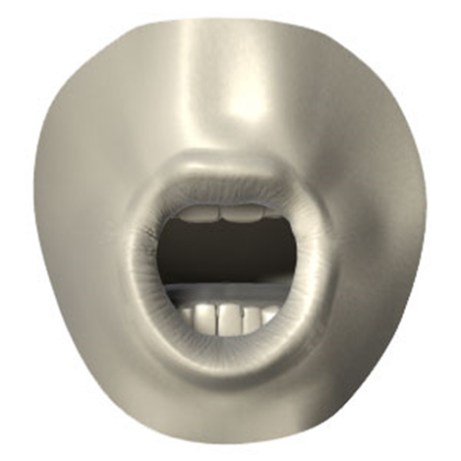
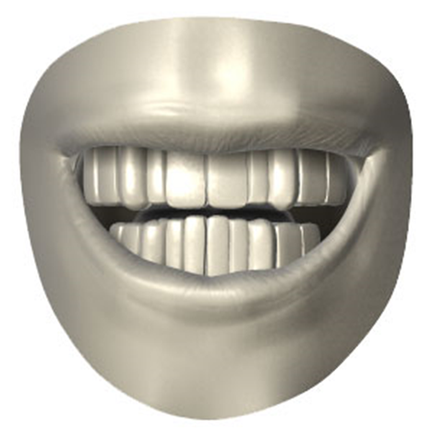
Brand personality
The sounds contained in brand names have been shown to influence consumer perception of brand personality
(Klink and Athaide, 2012)
Rugged
Sophisticated
Sincere

Slide 8
Research questions
Do sounds contained in a spokesperson’s name influence consumer judgements of spokesperson personality?
Does the meaning transfer to product personality?
Does spokesperson gender moderate the effect of sounds in a spokesperson’s name on consumer personality judgements?
Do consumer perceptions of personality traits mediate the effect of the interaction (spokesperson name x spokesperson gender) on brand attachment?

Slide 9
hypotheses
H1a: A spokesperson with a name containing back vowel sounds will be perceived as more outdoorsy, tough, and down-to earth than a spokesperson with a name containing front vowel sounds.
H1b: A spokesperson with a name containing front vowel sounds will be perceived as more cheerful, upper class, and charming than a spokesperson with a name containing back vowel sounds.
(Drawing from Klink and Athaide, 2012)

Slide 10
Hypotheses translated
Jordon Rozzo will be perceived as more outdoorsy, tough, and down-to earth than Jayden Razza.
Jayden Razza will be perceived as more cheerful, upper class, and charming than Jordon Rozzo.

Slide 11
Meaning transfer
McCracken’s (1989) Meaning Transfer Model – meaning transferred from a celebrity onto the product or brand, through the endorsement process
Perceived celebrity personality transfers onto brand personality (Ambroise et al., 2014)
More substantial for lesser known brands (Ambroise et al., 2014)
H2: Perceptions of spokesperson personality derived from the vowel sounds contained in the spokesperson’s name will transfer onto the product with which the spokesperson is paired.

Slide 12
Study 1
N=223 Australian consumers recruited through a professional panel company
Study 1a: n = 120, 54 male, 66 female; M_{Age} = 45.83, SD_{Age} = 16.88
Study 1b: n = 103, 49 male, 54 female; M_{Age} = 50.27, SD_{Age} = 16.48
Between Subjects Design
Participants randomly allocated to one of two experiment conditions
Front vowel spokesperson name (Study 1a: n = 60; Study 1b: n = 51) or
Back vowel spokesperson name (Study 1a: n = 60; Study 1b: n = 52).

Slide 13
Study 1 procedure
Study 1a – Completed Brand Personality Scale for the Spokesperson
Study 1b – Completed Brand Personality scale for the Product (watch)
Participants were asked to indicate the extent to which the personality attribute described the spokesperson/product (7-point scale, not very descriptive-very descriptive)
Jordon Rozzo is a spokesperson for a new watch.
Jayden Razza is a spokesperson for a new watch.

Slide 14
Study 1 results
 | Spokesperson (Study 1a) |  |  |  |  | Product (Study 1b)
 | Front Vowel |  | Back Vowel |  |  | Front Vowel |  | Back Vowel
 | M | SD | M | SD | t | M | SD | M | SD | t
BPS Facets
Down-to-earth | 3.65 | 1.13 | 4.92 | 1.87 | -4.49* | 3.71 | 1.27 | 4.54 | 1.62 | -2.91*
Honest | 3.73 | 1.06 | 4.22 | 2.14 | -1.57 | 3.78 | 1.17 | 4.04 | 1.63 | -.92
Wholesome | 3.88 | 1.33 | 4.07 | 1.83 | -.63 | 3.49 | 1.19 | 3.17 | 1.15 | 1.38
Cheerful | 5.62 | 1.72 | 4.73 | 1.68 | 2.85* | 5.14 | 1.52 | 4.08 | 1.69 | 3.34*
Upper Class | 5.17 | .81 | 4.30 | 1.40 | 4.23* | 5.25 | .84 | 4.27 | 1.34 | 4.44*
Charming | 3.77 | 1.29 | 4.05 | 2.07 | -.90 | 3.78 | 1.39 | 4.27 | 1.69 | -1.59
Outdoorsy | 3.57 | 1.27 | 4.87 | 1.85 | -4.50* | 3.51 | 1.33 | 4.81 | 1.74 | -4.25*
Tough | 4.18 | 1.27 | 5.63 | 1.71 | -5.28* | 3.04 | 1.46 | 4.87 | 1.61 | -6.04*
Table 1: Effect of Spokesperson Names on Personality Judgements for Spokesperson and Product: Jayden Razza and Jordon Rozzo.
Notes:
With exception of ‘Charming’ results replicate Klink 2012 (Charming was supposed to be front vowel sound)
Also provide evidence of a meaning transfer effect – with product related personality judgments mirroring those assigned to the spokesperson.

Slide 15
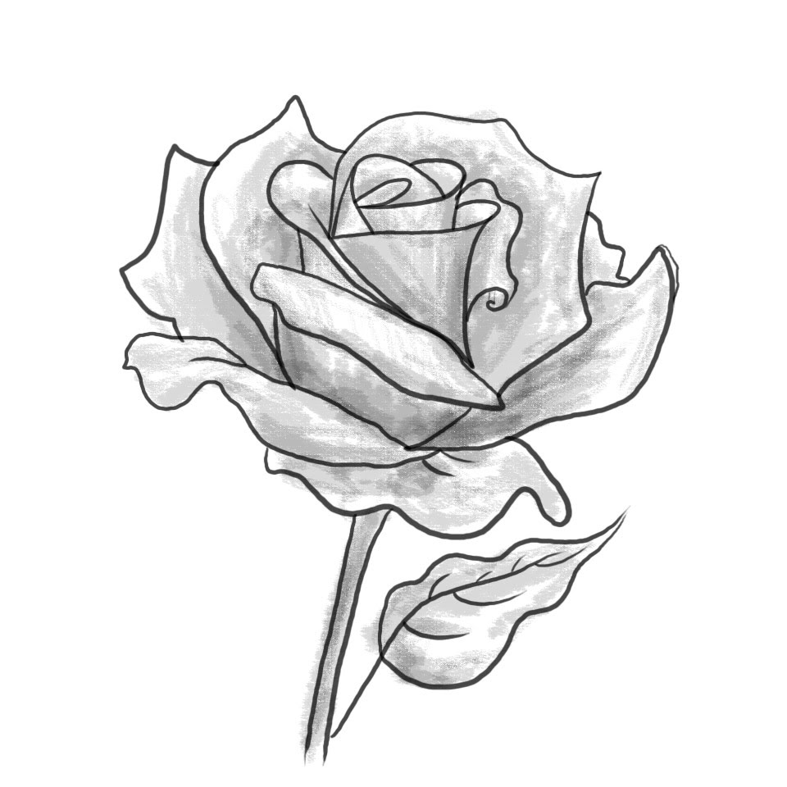
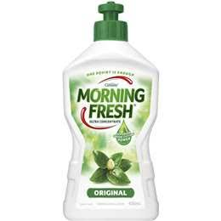
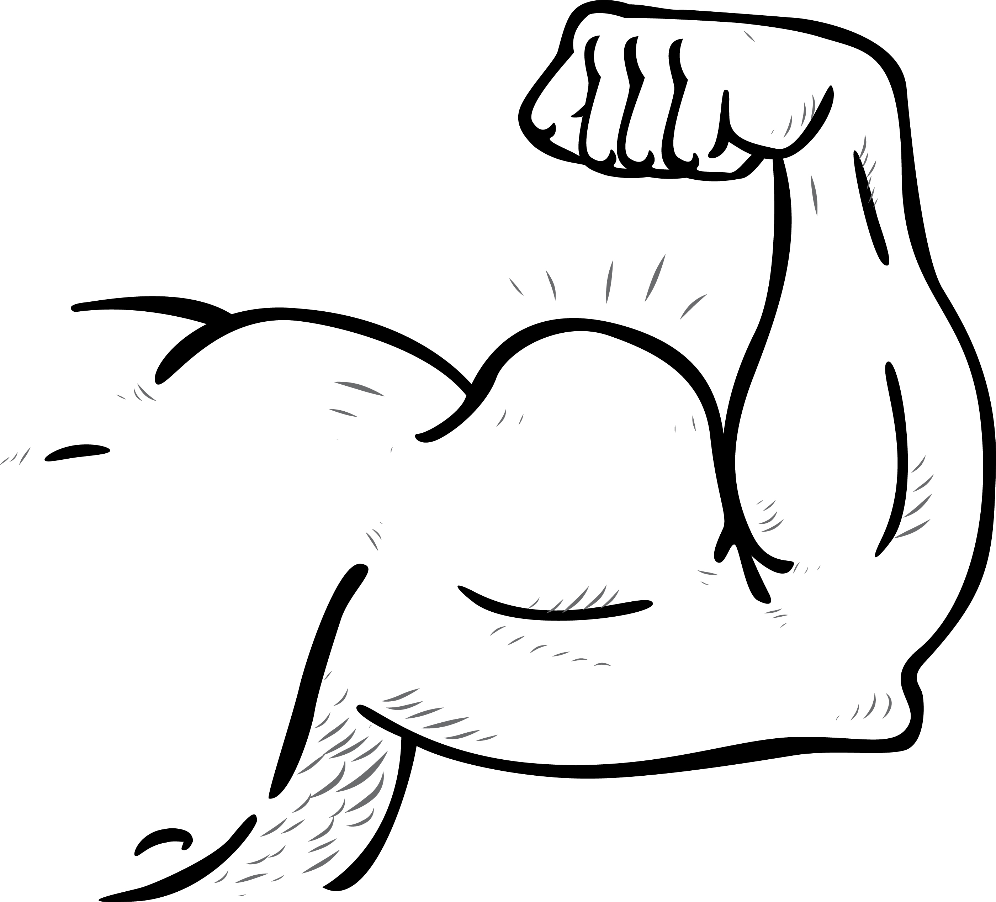
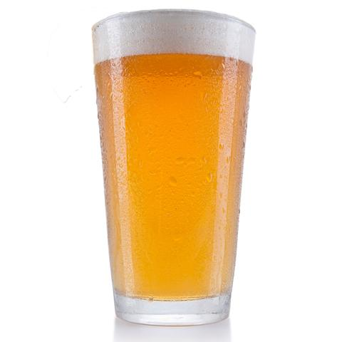
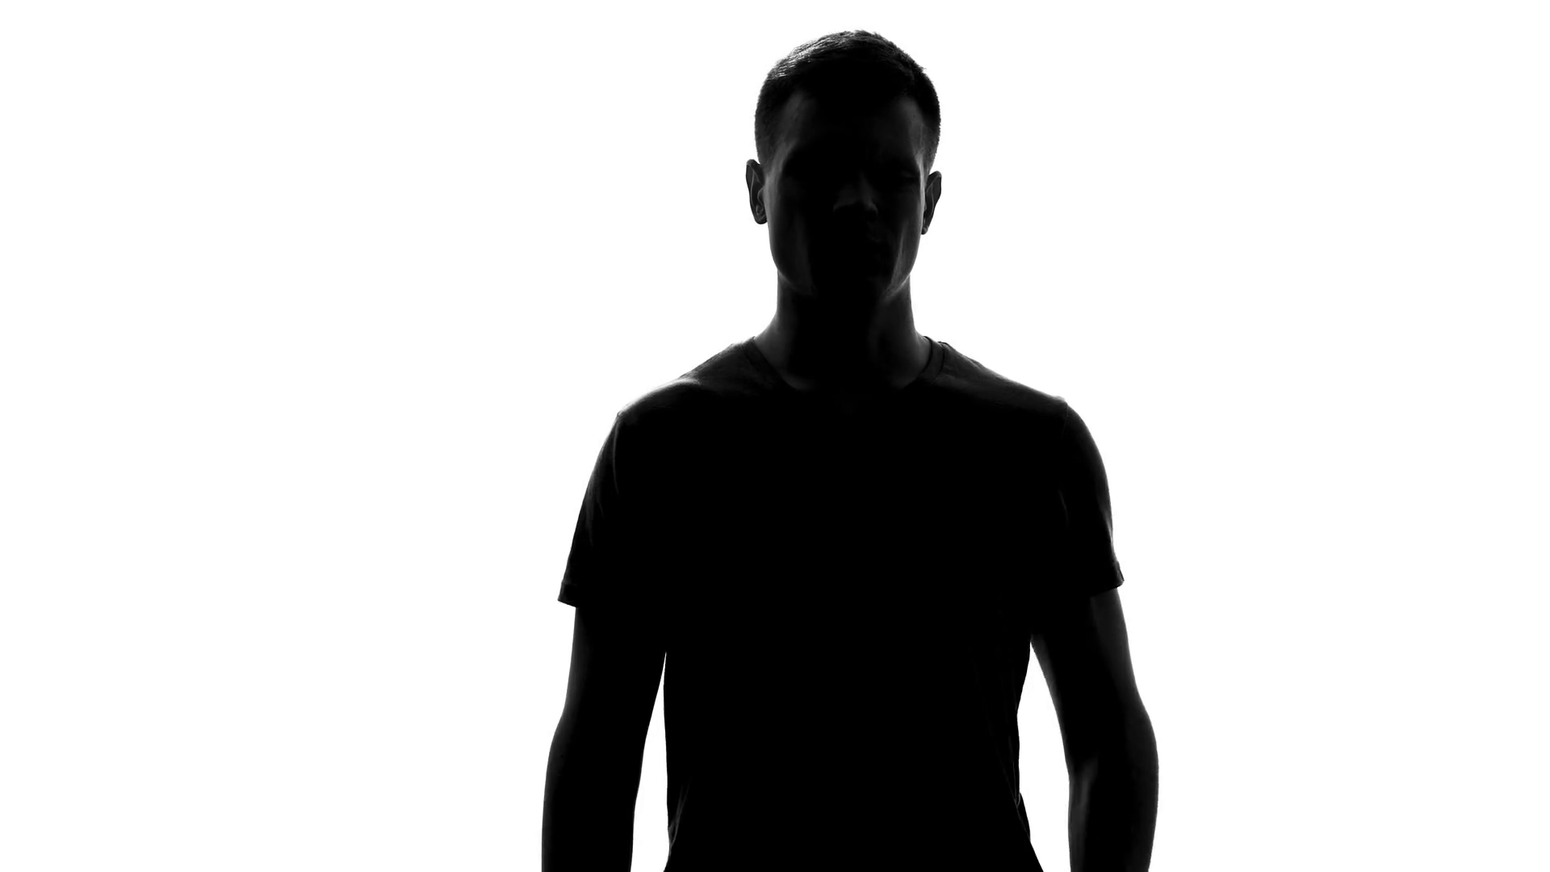
gender
Human names often imply, or are associated with a particular gender
Assigned to a male or female person
Female names are more likely to contain a high front vowel sound (e.g. /i/ as in Linda and Tina) in the stressed syllable of the name than males names (Crystal, 1995)
Front vowels associated with smaller and lighter objects, which are stereotypically associated with characteristics of females (Gordon and Heath, 1998)
Spokesperson’s gender influences the gender image assigned to a brand (Debevec and Iyer, 1986)

Slide 16
hypothesis
H3: The gender orientation of a spokesperson will influence the effect of sounds contained in gender neutral spokesperson names on (a) consumer perceptions of spokesperson personality traits; which in turn will transfer onto (b) an endorsed product.

Slide 17
Pre-tests (2)
N=60
Spokesperson Attractiveness, Spokesperson-Product fit for Male and Female Spokesperson
Attractiveness (t = -.25, p = .803)
Product congruence (t = .73, p = .471)
N=80
Personality Judgements attached to:
Odyn Tolley
Adyn Tilley

Slide 18
Pre-test
 | Front Vowel |  | Back Vowel
 | M | SD | M | SD | t | p
BPS Facets
Down-to-earth | 3.62 | 1.51 | 4.93 | 2.04 | -3.23 | .002
Honest | 4.05 | .64 | 4.00 | 1.06 | .26 | .799
Wholesome | 3.62 | 1.02 | 4.10 | 1.81 | -1.46 | .148
Cheerful | 5.03 | 1.53 | 3.78 | 2.07 | 3.07 | .003
Upper Class | 4.35 | 1.55 | 3.38 | 1.41 | 2.95 | .004
Charming | 4.05 | 1.83 | 4.70 | 1.86 | -1.58 | .118
Outdoorsy | 3.53 | 1.45 | 4.88 | 1.91 | -3.56 | .001
Tough | 3.40 | 1.08 | 5.48 | 1.34 | -7.62 | <.001
Table 2: Personality Judgements attached to spokesperson names: Adyn Tilley and Odyn Tolley

Slide 19
Study 2
N=212 Australian consumers recruited through a professional panel company
Study 2: 88 male, 124 female; M_{Age} = 45.35, SD_{Age} = 16.12
2 (spokesperson name: front/back) x 2 (spokesperson gender: female/male) Factorial Design
Participants randomly allocated to one of four experiment conditions

Slide 20
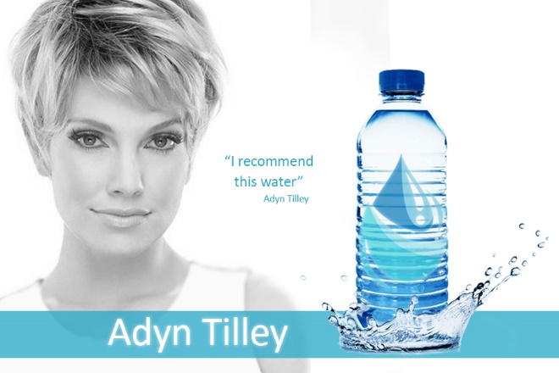
Study 2 procedure
Participants were asked to indicate the extent to which the personality attribute described the water (7-point scale, not very descriptive-very descriptive)

Slide 21
Study 2 – main effects
Main Effects: | Spokesperson Name |  |  |  |  | Spokesperson Gender
 | Front Vowel |  | Back Vowel |  | F | Female |  | Male |  | F
 | M | SD | M | SD |  | M | SD | M | SD
BPS Facets
Down-to-earth | 3.62 | 1.48 | 4.81 | 1.57 | 32.40* | 4.35 | 1.69 | 4.10 | 1.58 | 1.35
Honest | 3.91 | .95 | 4.02 | .93 | .64 | 4.00 | .89 | 3.93 | .99 | .25
Wholesome | 3.87 | 1.50 | 4.15 | 1.54 | 1.93 | 4.10 | 1.57 | 3.92 | 1.43 | .70
Cheerful | 4.76 | 1.51 | 3.75 | 1.48 | 23.85* | 4.17 | 1.59 | 4.34 | 1.56 | .63
Upper Class | 4.55 | 1.64 | 3.77 | 1.34 | 14.83* | 4.29 | 1.57 | 4.02 | 1.51 | 1.91
Charming | 4.02 | 1.48 | 4.39 | 1.71 | 2.88 | 3.89 | 1.51 | 4.53 | 1.65 | 8.72*
Outdoorsy | 3.77 | 1.55 | 4.64 | 1.78 | 16.09* | 3.97 | 1.42 | 4.45 | 1.98 | 12.26*
Tough | 3.67 | 1.40 | 4.35 | 1.83 | 10.25* | 3.66 | 1.50 | 4.36 | 1.76 | 10.61*
Main effects replicated those obtained in Study 1 and Study 2 pre-test.

Slide 22
Study 2 – interaction effects
Interaction Effects: | Female Spokesperson |  |  |  | Male Spokesperson
 | Front Vowel |  | Back Vowel |  | Front Vowel |  | Back Vowel |  | F
 | M | SD | M | SD | M | SD | M | SD
BPS Facets
Down-to-earth | 3.60 | 1.50 | 5.07 | 1.55 | 3.63 | 1.48 | 4.55 | 1.56 | 1.81
Honest | 3.92 | .76 | 4.07 | 1.01 | 3.91 | 1.11 | 3.96 | .85 | .13
Wholesome | 3.85 | 1.47 | 4.35 | 1.64 | 3.88 | 1.45 | 3.96 | 1.41 | 1.04
Cheerful | 4.63 | 1.50 | 3.71 | 1.55 | 4.89 | 1.52 | 3.79 | 1.42 | .18
Upper Class | 4.29 | 1.46 | 3.80 | 1.46 | 3.96 | 1.61 | 3.74 | 1.21 | .451
Charming | 4.06 | 1.55 | 3.72 | 1.47 | 3.98 | 1.42 | 5.08 | 1.69 | 11.49*
Outdoorsy | 3.98 | 1.48 | 3.96 | 1.39 | 3.57 | 1.60 | 5.34 | 1.87 | 16.75*
Tough | 3.69 | 1.31 | 3.63 | 1.67 | 3.64 | 1.50 | 5.09 | 1.72 | 12.21*
Table 3: Significant interaction effects were observed for the facets charming (F (1, 208) = 11.49, p < .001, η2 = .065), outdoorsy (F (1, 208) = 16.75, p < .001, η2 = .075) and tough (F (1, 208) = 16.75, p < .001, η2 = .075)

Slide 23
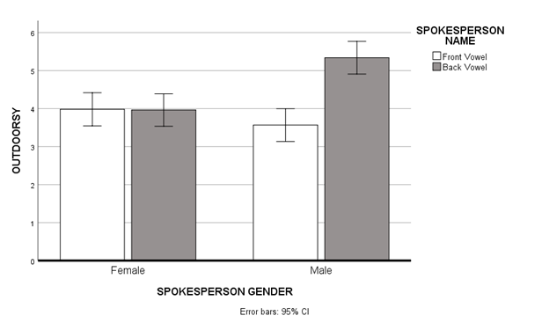
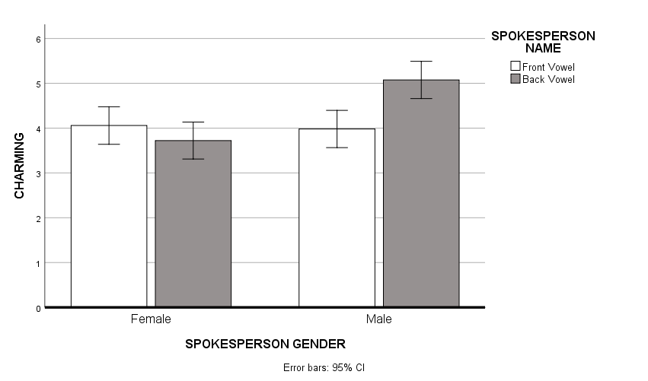
Product personality

Slide 24
Attachment
Relationship between brand personality and attachment (e.g. Sung et al., 2005)
Emotional brand attachment– connecting the brand with the self (Thomson, Maclnnis, and Park, 2006)
Measured using Thomson, MacInnis, and Park’s (2005) three-factor model:
(1) Affection - affectionate, loved, friendly, and peaceful
(2) Passion - passionate, delighted, and captivated
(3) Connection - connected, bonded, and attached
Notes:
link the object to the self and the self-concept

Slide 25
hypothesis
H4: Consumer perceptions of personality traits mediates the effect of the interaction (spokesperson name and spokesperson gender) on brand attachment.

Slide 26
ATTACHMENT RESULTS
The PROCESS macro bootstrapping procedure (n = 10000, Model 8) was employed with significant moderated mediated effects observed for:
Charming: β = .64, 95% CI = .26 to 1.07
Tough: β = .57, 95% CI = .23 to .98
Outdoorsy: β = .81, 95% CI = .38 to 1.28
Where the effect of gender on sounds contained in spokesperson names was significant – brand attachment was higher
Notes:
Only those where there was an interaction between spokesperson name and gender
When the personality traits are perceived to be consistent with the stereotypical spokesperson gender – brand attachment is higher
May be explained by an actual self congruence (Malar, Krohmer, Hoyer, and Nyffenegger, 2018, Journal of Marketing) between brand’s personality and self (or alignment with their way of thinking)

Slide 27
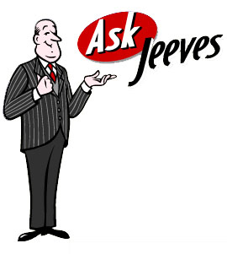
implications
Vowel Sounds in spokesperson names only influence personality perceptions when the spokesperson is male
Males offer more limitation but can be strategically utilized to heighten perceptions of charming, outdoorsy, or tough.
Spokesperson gender can attenuate phonetic symbolism effects – i.e. when the spokesperson is female
Careful consideration of spokesperson gender is required for the elicitation of required brand personality perceptions.
For example, a brand exerting resources into creating an outdoorsy brand personality through spokesperson name, should not adopt a female spokesperson.
However, females offer more flexibility and versatility for conveying personality traits, as sounds in their name will not interfere with other personality elements.

Slide 28
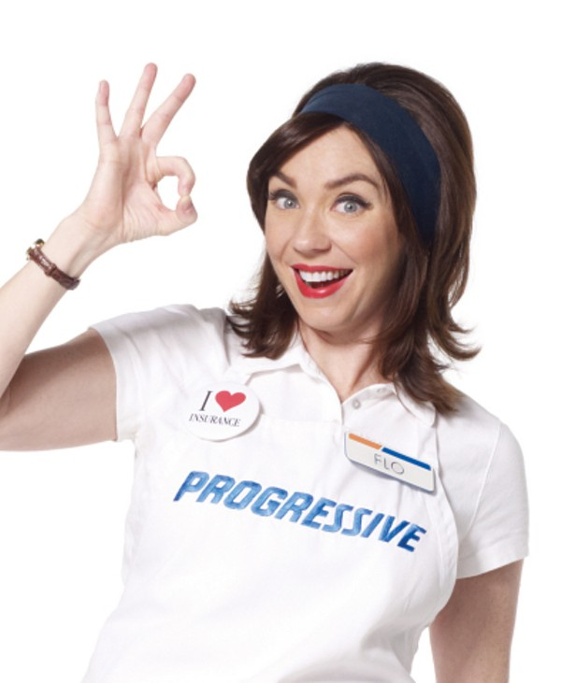
Thank you!

Slide 29
charming
Moderated Mediation
Predictors: | Beta | t | p
Dependent Variable: Charming (Model 1)
Spokesperson Name (X) | -.08 | -.26 | .799
Spokesperson Gender (W) | -3.20 | -2.97 | .003
X x W | 1.42 | 3.39 | <.001
Dependent Variable: Brand Attachment (Model 2)
Spokesperson Name (X) | .82 | 1.09 | .277
Spokesperson Gender (W) | -.14 | -.68 | .497
Charming (M) | .45 | 9.45 | <.001
X x W | -.42 | 1.42 | .156

Slide 30
tough
Moderated Mediation
Predictors: | Beta | t | p
Dependent Variable: Tough (Model 1)
Spokesperson Name (X) | -.05 | -.17 | .868
Spokesperson Gender (W) | -3.06 | -2.80 | .006
X x W | 1.50 | 3.49 | <.001
Dependent Variable: Brand Attachment (Model 2)
Spokesperson Name (X) | .56 | .71 | .481
Spokesperson Gender (W) | -.15 | -.72 | .475
Tough (M) | .38 | 7.79 | <.001
X x W | -.35 | -1.13 | .259

Slide 31
outdoorsy
Moderated Mediation
Predictors: | Beta | t | p
Dependent Variable: Outdoorsy (Model 1)
Spokesperson Name (X) | -.41 | -1.33 | .184
Spokesperson Gender (W) | -3.60 | -3.23 | .002
X x W | 1.79 | 4.09 | <.001
Dependent Variable: Brand Attachment (Model 2)
Spokesperson Name (X) | 1.01 | 1.35 | .176
Spokesperson Gender (W) | .01 | .06 | .951
Outdoorsy (M) | .45 | 10.01 | <.001
X x W | -.59 | -1.99 | .084

